Slide 1

AI-Powered Threat Hunting
Sean Wong
2025/08/05

Slide 2

AI Hunting Vision
Log Correlation
Intel Correlation
Behavioral Analytics
Endpoint Hunting
Automation Playbooks

Slide 3

Proactive Learning
Collaboration Reporting
Workshop Roadmap

Slide 4

01
AI Hunting Vision

Slide 5

AI Turns Data into Leads
Data Overload
Strategic Focus
Efficiency Gains
Modern SOCs are overwhelmed by terabytes of logs daily. AI helps by correlating events, identifying anomalies, and prioritizing threats, transforming raw data into actionable leads for analysts.
AI automation allows analysts to shift their focus from manual data sorting to strategic investigation, threat attribution, and proactive defense planning, enhancing overall security posture.
By automating repetitive tasks, AI reduces the time analysts spend on low-level triage, enabling them to concentrate on high-impact activities like threat hunting and incident response.

Slide 6

Human-AI Partnership Rules
Machine Strengths
Humans retain control over strategic decisions, contextual analysis, containment approvals, and legal interpretations, ensuring AI actions align with organizational goals and ethics.
AI excels at handling repetitive tasks like correlation, anomaly detection, and draft reporting, providing speed and accuracy that humans cannot match.

Slide 7
02
Log Correlation

Slide 8

AI Links Events Across Sources
Unified View
Risk Scoring
AI integrates logs from firewalls, authentication systems, DNS, and endpoints, creating a unified view of network activity and revealing multi-stage attack timelines.
AI assigns dynamic risk scores to detected events, helping analysts prioritize their attention and focus on the most critical threats first.
Hidden Threats
Tool Integration
AI algorithms detect hidden command-and-control (C2) beacons and slow lateral movement that traditional tools often miss, enhancing threat detection capabilities.
Tools like Splunk ML, Microsoft Sentinel, and Elastic Security leverage AI to automate log correlation and anomaly detection, streamlining SOC workflows.

Slide 9

Noise Reduction
AI algorithms group related alerts into single incidents, suppress low-fidelity signatures, and highlight true-positive patterns, significantly reducing alert noise and preventing analyst burnout.
Alert Deduplication Cuts Noise

Slide 10
03
Intel Correlation

Slide 11

AI Maps IOCs to Internal Logs
Context Enrichment
AI matches external threat intelligence feeds with internal logs, enriching alerts with malware family context, campaign tags, and confidence scores to accelerate prioritization.
Tool Integration
Platforms like Recorded Future, ThreatConnect, and Anomali use AI to map IOCs to internal logs, providing actionable insights for threat hunters.

Slide 12

Emerging Threat Predictions
Early Detection
Proactive Defense
Tool Integration
AI models analyze open-source chatter, vulnerability disclosures, and dark-web indicators to forecast likely attack vectors, enabling early detection and response.
By predicting emerging threats, AI helps organizations stay ahead of adversaries, allowing them to prototype new detection rules and strengthen defenses proactively.
AI-driven threat prediction tools integrate with existing SOC workflows, providing real-time alerts and recommendations for proactive threat hunting.

Slide 13
04
Behavioral Analytics

Slide 14

UEBA Spots Stealthy Anomalies
Baseline Behavior
Stealthy Threats
Tool Integration
AI establishes baselines for user, host, and network behaviors, enabling the detection of subtle anomalies that indicate potential threats.
AI identifies stealthy threats like compromised accounts, insider threats, and dormant implants that traditional signature tools often overlook.
Platforms like Darktrace, Vectra, and Exabeam use AI to provide UEBA capabilities, enhancing threat detection and response.

Slide 15

Risk Scores Prioritize Hunts
Dynamic Scoring
Efficient Allocation
AI assigns dynamic risk scores to detected anomalies, helping analysts prioritize their hunting efforts and focus on the most critical threats.
Risk scoring ensures that limited hunting resources are allocated efficiently, maximizing the effectiveness of threat hunting activities.

Slide 16
05
Endpoint Hunting

Slide 17

AI Traces Process Ancestry
Tool Integration
Tools like CrowdStrike, SentinelOne, and Defender AI use AI to enhance endpoint threat detection and response capabilities.
Early Detection
AI helps detect early-stage ransomware and other malware by identifying unusual process behavior and persistence techniques.
Process Monitoring
AI monitors process creation, registry edits, and memory injections on endpoints, revealing suspicious activity chains that indicate potential threats.

Slide 18

Script Analysis
AI evaluates obfuscated scripts, predicting malicious intent and highlighting de-obfuscated snippets to identify weaponized documents or malware.
Efficient Detection
Script Classification Flags Malware
AI-driven script classification reduces the need for manual decoding, enabling faster and more efficient detection of malicious scripts.

Slide 19
06
Automation Playbooks

Slide 20

Query Generation
Automated IOC Sweeps
AI analyzes past successful hunts to suggest new queries, ensuring institutional knowledge is leveraged even when senior analysts are unavailable.
AI schedules IOC sweeps across endpoints, integrating with SOAR platforms to automate repetitive investigation tasks and streamline workflows.
AI Suggests Hunting Queries
AI triggers enrichment actions like threat-intel lookups, providing analysts with pre-enriched case packages that accelerate investigation.
Platforms like Cortex XSOAR and Demisto use AI to enhance automation playbooks, improving threat hunting efficiency.
Enrichment Actions
Tool Integration

Slide 21

Automated Playbooks Accelerate Triage
Efficient Triage
AI-driven playbooks automate triage, providing consistent response quality and reducing investigation startup time across shifts.

Slide 22
07
Proactive Learning

Slide 23

Hypothesis Generation
AI suggests new hunting hypotheses based on uncovered TTPs, generating corresponding log queries and outlining required data sources.
AI Recommends Next Hypotheses
Continuous Exploration
AI-driven hypothesis generation fosters continuous proactive exploration, enabling threat hunters to stay ahead of evolving threats.

Slide 24

Guided Learning Upskill Juniors
Interactive Prompts
AI provides interactive prompts that explain detected behaviors, recommend investigative steps, and offer contextual threat intel.
Tool Integration
Skill Development
Platforms like MITRE ATT&CK AI plugins and OpenAI Codex integrate with existing workflows to enhance learning and skill development.
AI-driven learning tools help junior analysts build hunting intuition safely, reducing mentorship overhead for senior staff.

Slide 25
08
Collaboration Reporting

Slide 26
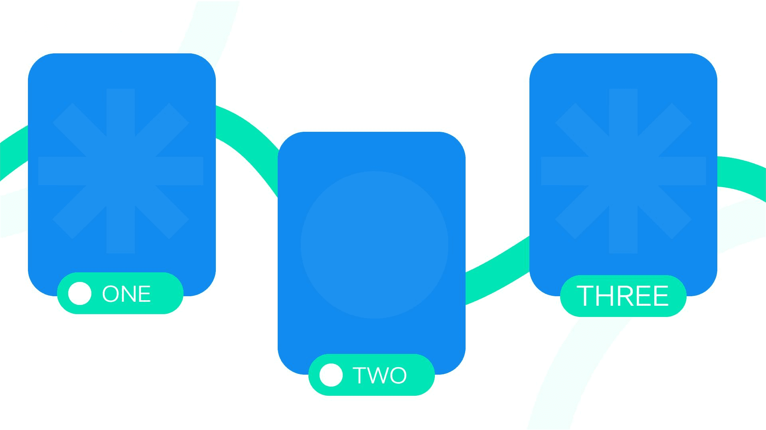
AI Summarizes Hunt Findings
Threat Briefs
Tool Integration
AI condenses IOC tables, timeline narratives, and MITRE mappings into concise threat briefs, accelerating intel sharing across SOCs.
Platforms like MISP, ThreatConnect, and Recorded Future use AI to enhance threat intelligence sharing and collaboration.
Consistent Reporting
AI ensures consistent reporting standards, providing leadership and peer teams with actionable insights for rapid response.

Slide 27

Gap Detection
AI compares hunted techniques against existing detection rules, identifying gaps and recommending new rule drafts to strengthen defenses.
Coverage Gap Identification
Continuous Improvement
AI-driven gap identification turns each hunt into a feedback loop, continuously improving detection capabilities and reducing dwell time.

Slide 28
09
Workshop Roadmap

Slide 29

Task Scoring Matrix Drill
Task Identification
Efficiency Gains
Participants list recurring hunting tasks and score them based on data volume, repetition, correlation need, and documentation load.
AI automation reduces the time analysts spend on low-level triage, enabling them to concentrate on high-impact activities like threat hunting and incident response.
Balanced Workload
Pilot Proposals
High-score tasks are selected for AI pilot proposals, ensuring investment focuses on workflows with measurable efficiency and accuracy gains.
By automating repetitive tasks, AI ensures a balanced workload, allowing analysts to focus on strategic activities and reducing burnout.

Slide 30

Pilot-to-Scale Adoption Plan
Adoption Strategy
Start with alert deduplication or IOC enrichment, run a pilot with volunteer hunters, capture improvements, and expand AI to other areas while maintaining human oversight.

Slide 31

2025/08/05
Sean Wong

